Slide 1
COVID-19 Vaccine Overview

Slide 2
COVID Impact on Communities of Color
https://covid19.ca.gov/equity/

Slide 4
Common Concerns
Mistrust based on historic and contemporary mistreatment of Black, Latino, Asian, Pacific Islander, American Indian communities
Vaccine developed under political pressure
Vaccine is new and developed quickly
Lack of universal trusted source of information, different sources of different information, inconsistent information
Concerns of vaccine hesitancy are valid, respectable, and should be answered by a qualified physician or agency

Slide 5
Benefits of Getting Vaccine
Vaccination protects you, your family, and your community from any symptomatic COVID-19
Pfizer and Moderna vaccines are both 95% effective in preventing ANY symptoms of COVID-19
Annual flu vaccines are usually only 40-60% effective yet they have reduced the flu, severe cases of the flu, and death
Reduces the chance of hospitalization and death from COVID-19
Being unvaccinated may increase your risk of getting COVID-19 and serious long-term complications

Slide 6
Vaccine Development Was the vaccine rushed?
Scientists developed vaccine, not the government
Vaccine was developed and tested quickly, but safely. There were no “skipping” of steps.
Lots of government and private funding + more cooperation across scientific labs nationally and internationally = multiple expensive clinical trials at the same time
Vaccine technology has been studied for many years
Think of it like when we moved from rotary phones to cellular phones

Slide 7
What is in the vaccine? How does the vaccine work?
The vaccine includes protein (mRNA), fats (called lipids), salt and sugar (preservatives)
The vaccine has no animal products (halal) or thimerosal. No fetal tissue was used to make the vaccine. These vaccines do not contain any parts of the coronavirus and cannot cause COVID-19.
Cannot alter your DNA in any way
The mRNA is a messenger that teaches your body how to recognize and respond to COVID-19. Then it disappears.
Like Snapchat
mRNA technology has been studied for over 30 years

Slide 8
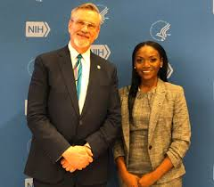
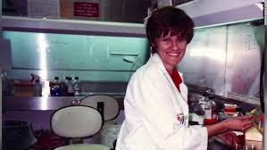
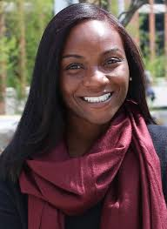
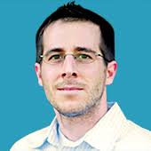
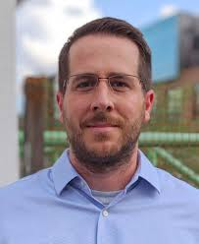
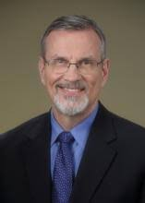
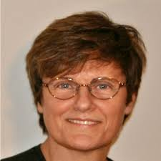
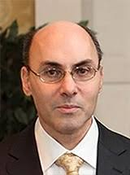
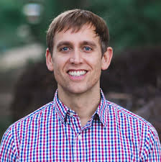
Timeline of mRNA technology and key figures in vaccine development
First iPhone
Facebook launches
Dr. Graham and Dr. Corbett get genetic code for virus to create structure-based SARS-CoV-2 vaccine with Moderna
1990s
SARS-CoV-1
2012
MERS
2013
SARS-CoV-2
2002
Dr. Katalin Karikó begain studying mRNA technology for humans at Temple, then UPenn
2020
Dr. Graham and Dr. Jason McLellan solved way to modify RSV virus prefusion spike protein to allow for successful structure-based vaccine
2017
Dr. McLellan (UT Austin) and Dr. Andrew Ward (Scripps Research) figured out coronavirus prefusion spike structure
Dr. Karikó joins BioNTech to oversee mRNA research
Dr. Graham partners with Moderna for mRNA MERS vaccine
2000
Dr. Barney Graham, head of Vanderbilt AIDS Vaccine Evalution Unit, recruited as one of founders of NIH Vaccine Research Center
2014
Dr. Kizzmekia Corbett appointed to NIH Vaccine Research Center after years of working on viruses and vaccines
2005
Dr. Karikó and Dr. Drew Weissman created successful synthetic mRNA delivery system
First camera phone
Twitter launches
@ScrippsSHARCs
https://cen.acs.org/pharmaceuticals/vaccines/tiny-tweak-behind-COVID-19/98/i38
Notes:
https://www.nature.com/articles/d41586-020-03626-1

Slide 9
Were people like me part of the clinical trials?
Over 70,000 people participated in Pfizer and Moderna trials and were equally safe for all:
Adults, all ages (65+, over 85% effective)
Race/ethnicities (Black, Latino, other communities of color, over 95% effective)
Chronic conditions (about 90% effective)
The vaccine is safe and can prolong your immunity if you have already had COVID-19.

Slide 10
Race/Ethnicity in COVID-19 Clinical Trials
Moderna and Pfizer clinical trials included a broad range of diverse participants
Moderna
Pfizer
Percent | Racial/Ethnic group
20.5% | Hispanic/Latino
9.7% | Black
4.7% | Asian
2.1% | Multiracial
0.8% | American Indian
0.2% | Pacific Island
Percent | Racial/Ethnic group
26.2% | Hispanic/Latino
9.8% | Black
4.4% | Asian
2.5% | Multiracial
0.6% | American Indian
0.2% | Pacific Island

Slide 11
Vaccine Effectiveness: Race/Ethnicity Data

Slide 12
Side Effects
Most side effects are mild, may occur over a few days, and can be stronger after your second dose.
Common side effects include pain or muscle ache, fatigue, headache, nausea, chills, and fever.
After vaccination, medical personnel will monitor you for 15 minutes to ensure you get any necessary treatment if you have a reaction (medical treatment & personnel on site)

Slide 13
Side Effects
Serious side effects are rare. The vaccine is safe for you if you have seasonal, pet, or food allergies.
If you have a history of anaphylaxis (severe allergic reactions), previous vaccine reactions, are allergic to polysorbate or ethylene glycol, talk to your doctor.
There is no evidence the vaccine affects fertility.
Talk to your doctor if you: are immunocompromised or are taking medication that affects your immune system, have been unable to receive vaccinations in the past because of a blood thinner or a bleeding disorder, have a fever, are pregnant, or plan to become pregnant.

Slide 14
@ScrippsSHARCs

Slide 15
Which vaccine is better? Can I choose?
Both Pfizer and Moderna vaccines are about 95% effective.
At this point, due to limited supply, you cannot choose.
Pfizer and Moderna each have two doses, spaced apart 3-4 weeks.
Your first shot needs to be the same as your second shot.
Pfizer approved for people over 16; Moderna is approved for people over 18.

Slide 16
Do I need both shots?
Yes. The current vaccines have two doses, spaced apart 21 or 28 days. It is possible to get infected with COVID-19 before your second dose because you are not yet fully protected.
Will I have to take the vaccine again?
Scientists are not sure how long the vaccines will protect people. They are continuing to monitor the data in order to make recommendations. It’s possible there will be a need for booster shots in the future.
What is known is that you need both doses (shots) for the Pfizer and Moderna vaccines to be effective.

Slide 17
Will the vaccines protect against new mutations?
So far, the current vaccines appear to still protect you against the new mutation (it doesn’t appear to be a significant change).
How much will it cost?
The vaccines have been covered by taxpayer dollars, so they will be free to everyone.

Slide 18
Why are some communities, such as Black, Latinx, American Indian, Pacific Islander, or Asian American, being encouraged to get the vaccine?
Some communities (such as Black/African American, Latino/x, American Indian, Pacific Islander, Indigenous, and Asian populations) may be offered the vaccines earlier than others because their infection, hospitalization, and death rates have been disproportionately high.
This is related to higher rates of exposure (essential work, multigenerational households, etc). For this same reason, prevention is crucial.

Slide 19
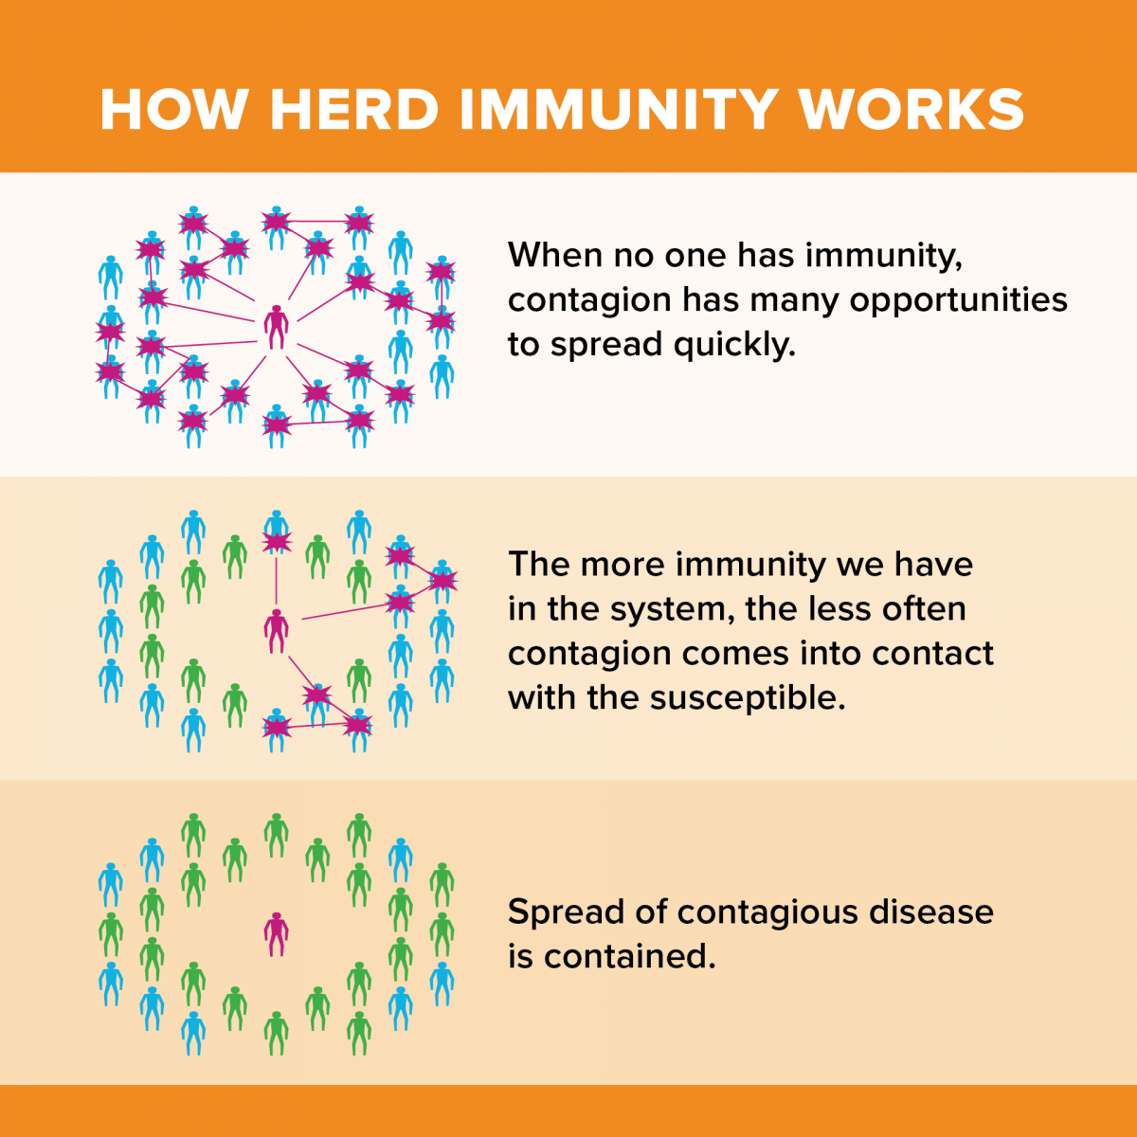
What is herd immunity? How does it work?
We reached herd immunity for measles, mumps, polio, and chickenpox in the U.S. through vaccines.
Scientists expect herd immunity with 80-90% of people vaccinated.
However, herd immunity applies to the community around you. That’s why you’ll see outbreaks (e.g., measles) in communities with low vaccine uptake.
Herd immunity without a vaccine will result in catastrophic numbers of deaths.
https://www.ucdavis.edu/covid-19/what-to-know-about-herd-immunity/
https://www.jhsph.edu/covid-19/articles/achieving-herd-immunity-with-covid19.html

Slide 20
Should I get the vaccine even if I already had COVID-19?
Yes. Protection from the vaccine is safe and can prolong your immunity. You can wait up to 90 days after infection for vaccination but can receive it as soon as local regulations allow.
Do I still need to wear a mask after getting the vaccine?
Yes. The vaccines protect YOU from getting sick from COVID-19, but it is unclear whether you may still get mild or symptom-free cases, then transmit COVID-19 to others. Continue to follow public health guidelines, such as wearing a mask, social distancing, and avoiding indoor crowds.

Slide 21
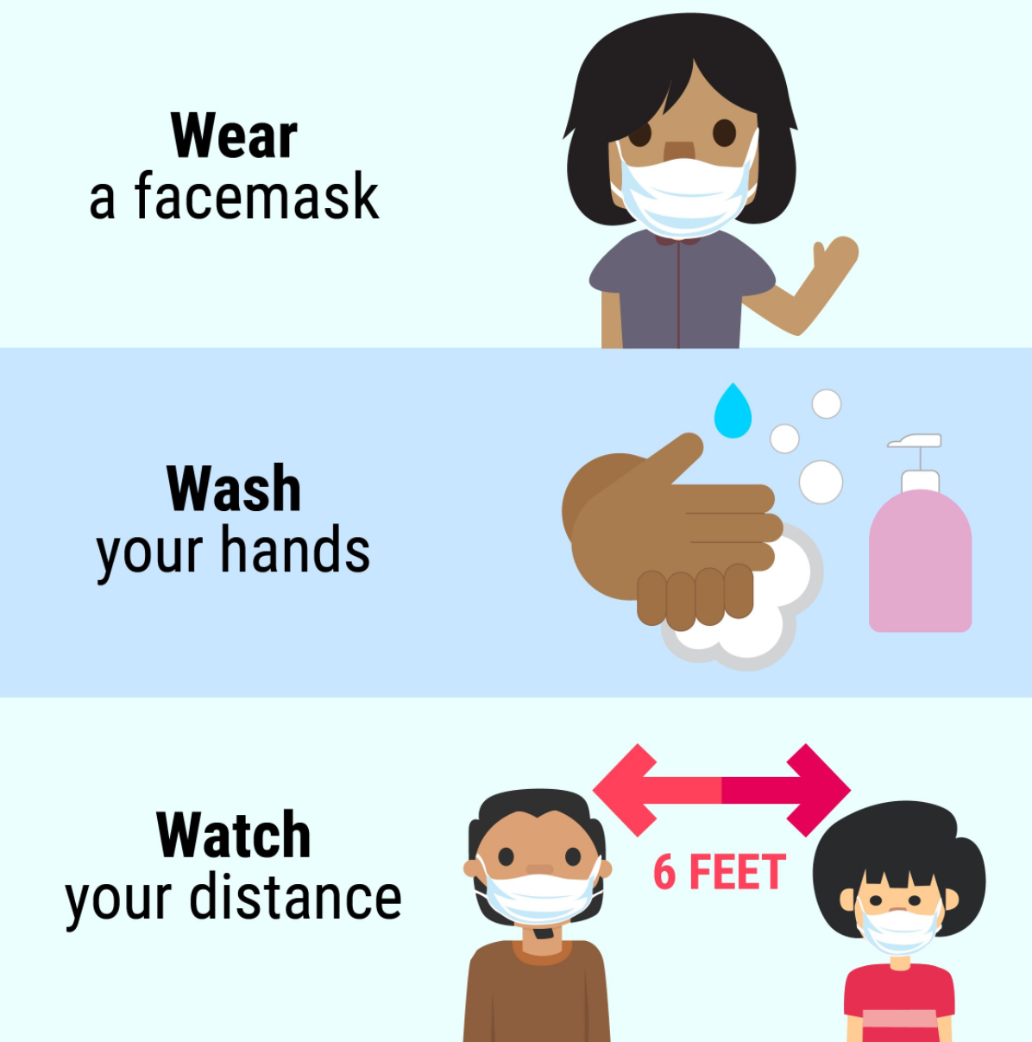
Remember the 3 W’s
Even after getting the vaccine!

Slide 22
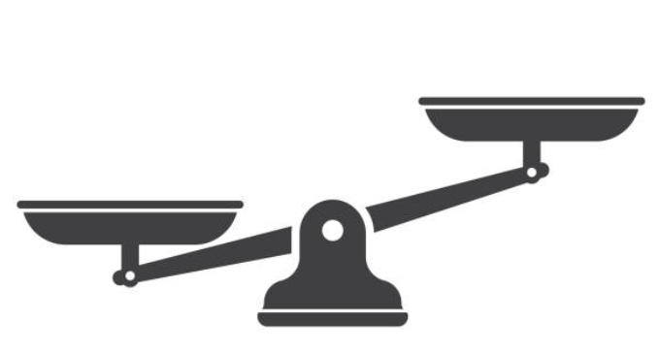
Weighing the Risks: Infection vs. Vaccination
Every million COVID-19 vaccinations
~2-3 serious reactions
~1-2 hospitalizations
1-2 deaths under investigation
Every million cases of COVID-19 infection
~15,000 deaths
~70,000 hospitalizations
Moderna and Pfizer vaccine each reported 10 serious allergic reactions out of 4 million doses (as of 1/23/21)

Slide 23
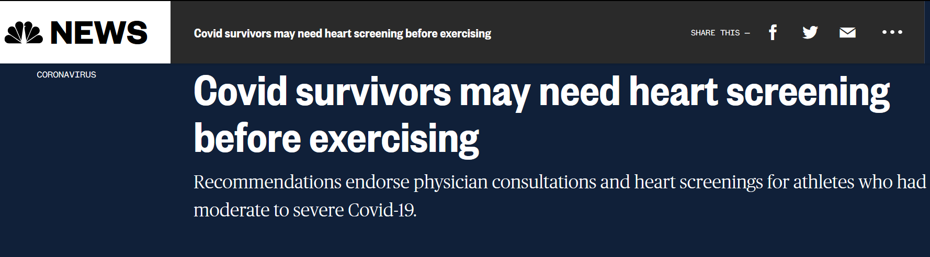
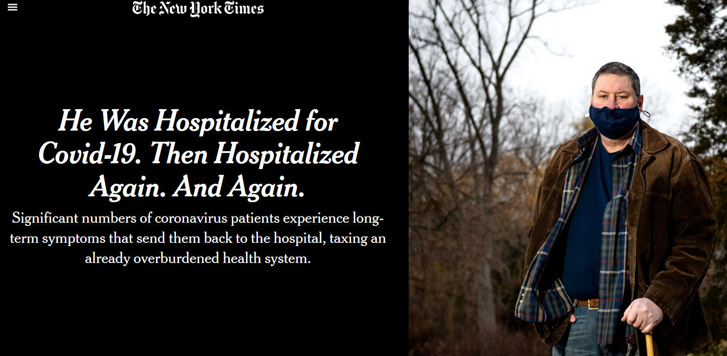
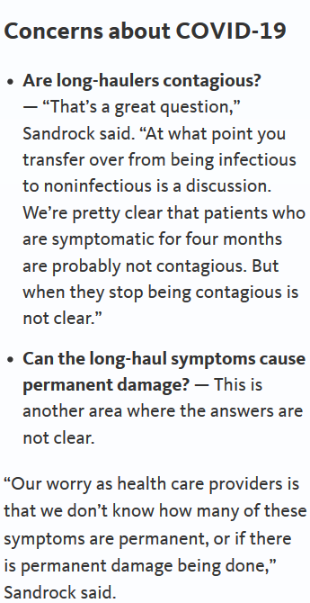
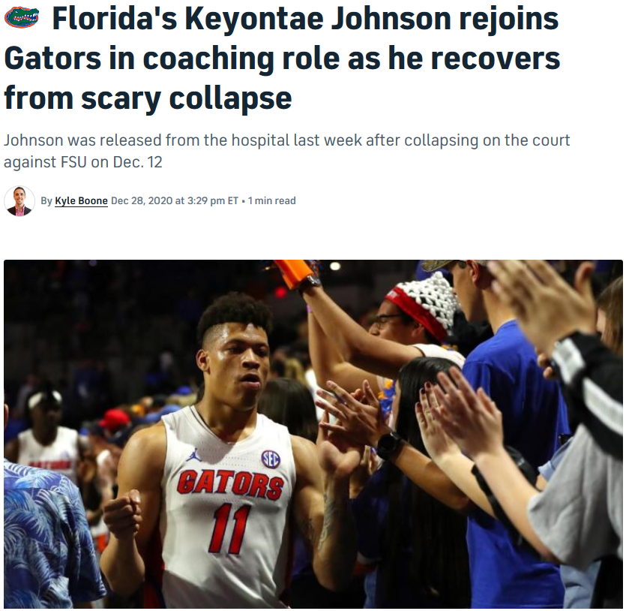
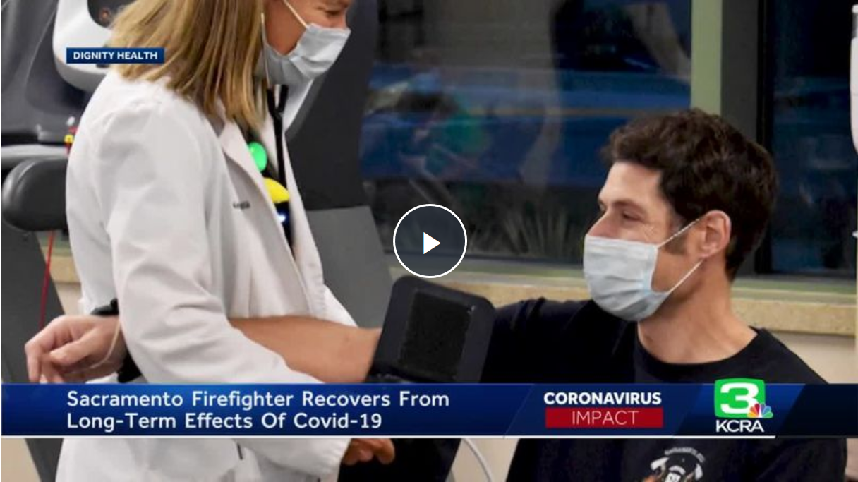
Long-Term Risks of COVID-19
@ScrippsSHARCs
Notes:
https://www.jacc.org/doi/pdf/10.1016/j.jcmg.2020.10.005
https://www.kcra.com/article/its-been-really-long-journey-firefighters-covid-recovery-long-haul/35078568
https://www.universityofcalifornia.edu/news/frightening-uncertainty-long-haul-covid-19

Slide 24
Key Takeaways
Lot of misinformation in social media and word-of-mouth
Black, Latino, Asian, Pacific Islander, American Indian communities are contracting disease and dying at higher rates
“Side effects” of contracting COVID-19 disease is far worse than side effects of getting the vaccine
Why consider taking vaccine if you have mistrust? Because we want everyone to stay alive today to help fight mistrust tomorrow.

Slide 25
Resources
STOP COVID-19 CA website: https://www.stopcovid-19ca.org/
COVID-19 Vaccine FAQ in community-friendly language: English and Spanish
NIH CEAL (Community Engagement Alliance) Against COVID-19 Disparities website: https://covid19community.nih.gov/
CDC COVID-19 Vaccine Communications Toolkit for CBO: https://www.cdc.gov/coronavirus/2019-ncov/vaccines/toolkits/community-organization.html
CDC COVID-19 website: https://www.cdc.gov/coronavirus/2019-ncov/index.html
ASTHO (Association of State and Territorial Health Officials) COVID-19 website: https://astho.org/COVID-19/

Slide 26
Other possible useful slides follow

Slide 27
Jan 25, 2021
State Population 39M
COVID Cases 3.136M
COVID Deaths 37,543

Slide 28
What safeguards are in place now to protect people of color?
The Belmont Report was created in response to the Tuskegee Syphilis Study – it applies to all people but was done in response to mistreatment to people of color
3 principles for ethical conduct of research involving human participants: 1) Respect for persons; 2) Beneficence; and 3) Justice.
Institutional Review Board (IRB), must approve every US clinical trial.
The IRB is made up of doctors, scientists, and lay people, dedicated to making sure that the study participants are not exposed to unnecessary risks.
Informed consent process also helps protect participants.
Before joining a clinical trial, study participants will be told what to expect and all the things that might happen.
Large clinical trials have a Data Safety Monitoring Board
New medications and vaccines also go through FDA Review

